Slide 1
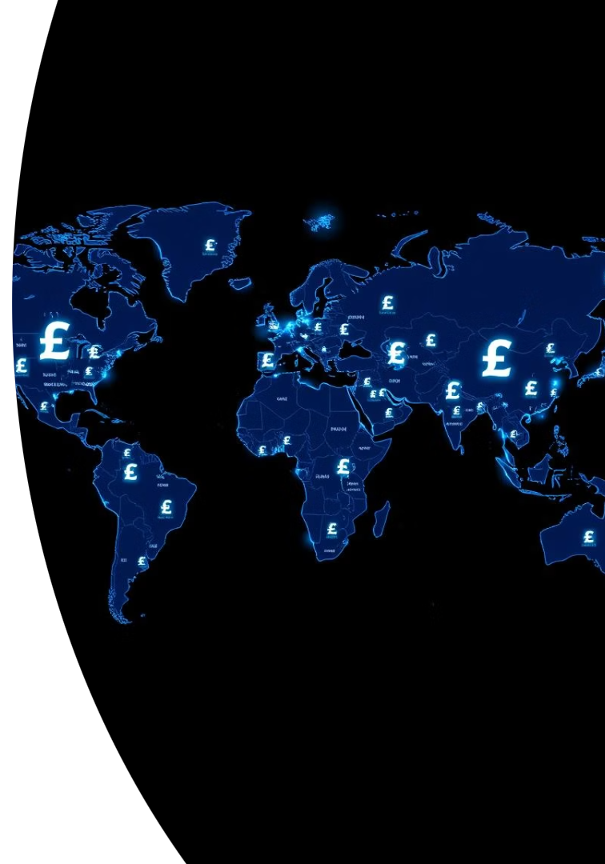
Currency Converter: Navigating a Globalized World
Currency converters are vital in our interconnected world. They facilitate the massive daily forex market volume. These tools are essential for travel, commerce, and finance. They seamlessly bridge over 180 global currencies.

Slide 2





The Growing Need for Seamless Conversion
E-commerce Growth
Cross-border e-commerce reached $1.25 trillion. This highlights global purchasing power.
Remittance Volume
Global remittances totaled $831 billion in 2022. Families depend on easy money transfers.
Tourism Revival
International tourism is rebounding strongly. It drives diverse currency needs.
Transaction Flow
Converters eliminate friction. They ensure smooth global transactions.

Slide 3





How Currency Converters Work
Real-Time Rates
Based on live interbank exchange rates.
Data Sources
Sourced from major financial institutions.
Constant Updates
Reflects market changes every few seconds.
Bid/Ask Spreads
Displays accurate buy/sell rates.

Slide 4
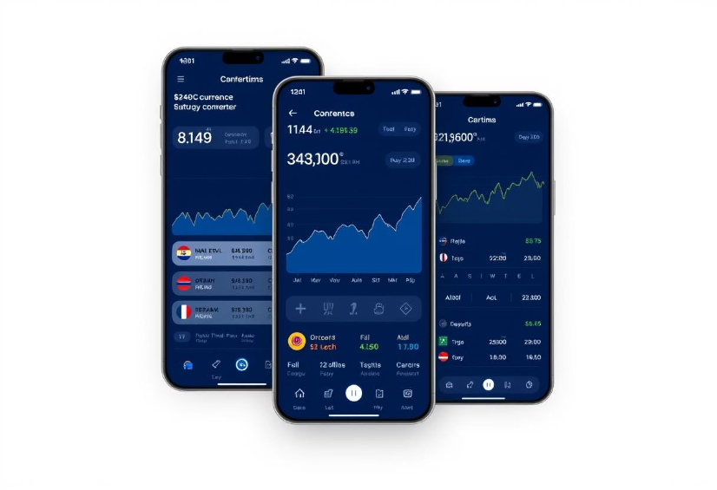
Key Features of Effective Converters
Real-time data refresh (<10s latency)
High accuracy (±0.01% deviation)
Comprehensive coverage (150+ currencies)
Effective converters offer precise, up-to-date information. They provide historical data access. Built-in cost estimations aid financial planning.

Slide 5





Practical Applications and Use Cases
Travel Planning
Online Shopping
Business Operations
Budget trips, avoid hidden fees (e.g., $1 = ¥155).
Compare prices across international retailers.
Manage international invoicing and payroll.
Investment Tracking
Monitor portfolio value in different currencies.

Slide 6

Challenges and Considerations
Volatility
Major currency pairs fluctuate daily. This impacts transaction value.
Hidden Fees
Banks often add 2-5% to interbank rates. Always check the final cost.
Data Latency
Some free tools may offer delayed data. This can lead to inaccuracies.
Regulatory Compliance
Adherence to diverse financial regulations. Rules vary by region.

Slide 7





The Future of Currency Conversion
Blockchain
Offers faster, cheaper cross-border transfers. Stablecoins reduce volatility.
AI/ML
Enables predictive analytics for exchange rates. Anticipate market trends.
Embedded Finance
Conversion integrated directly into apps. Seamless financial experiences.
CBDCs
Central Bank Digital Currencies. Potential for instant inter-country payments.

Slide 8

Conclusion: Empowering Global Transactions
Informed Decisions
Essential tool for smart financial choices.
Seamless Global Flow
Facilitates worldwide commerce and travel.
Continuous Innovation
Drives greater accuracy and speed.
Connected World
Embrace reliable converters for true global connection.

Slide 9

Start Converting Smarter Today!
180+
50M+
<1s
Currencies Supported
Users Worldwide
Average Response Time
Convert between virtually any major or minor currency.
Trusted by millions for accurate, real-time conversions.
Get your conversion results almost instantly.
Ready to experience effortless global finance? Our currency converter empowers you. It provides instant, accurate conversions. Join millions who trust our service daily.

